Slide 1



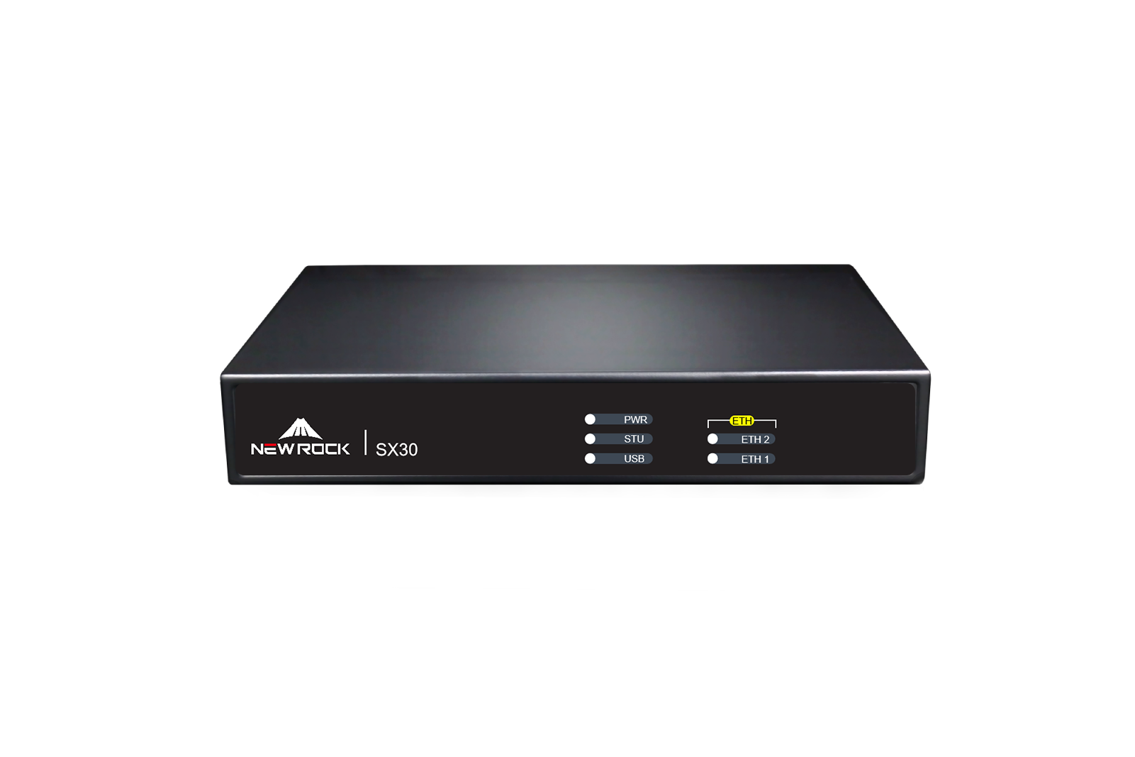
OM 80EA IPPBX
SX 30 Session
Border Controller
Packet forwarding latency: < 30 ms
The SX30 is a session border controller (SBC) designed by New Rock for small and medium-sized enterprises (SMEs). It delivers robust session-level security and data protection, ensuring secure communications across evolving enterprise voice networks. The SX30 effectively addresses challenges such as mobile workforce enablement, branch connectivity, and multi-network convergence.
Concurrent sessions: 20 (unencrypted) /
10 (encrypted)
Registered users: 200 (encrypted / unencrypted)
The SX30 is typically deployed at the edge of an enterprise network or VPN. It securely and efficiently connects IP sessions from remote branch offices to the enterprise’s internal unified communications system (such as an IP-PBX) over VPN or the public Internet. The SX30 can also be positioned between a carrier’s private voice network (e.g., an IMS network) and the enterprise intranet, enabling seamless access from the enterprise’s communication system to the operator’s IP-based voice services.
Product Features
Firewall/NAT traversal capability
Voice proxy for inter-network IP phone communication
Encryption and decryption of signaling and media streams for secure communications
Voice quality monitoring (e.g., packet loss rate) to ensure call quality
SIP terminal registration and authentication
Network failover and disaster recovery support
VoIP protocol port mapping and transformation
Security features including whitelist control, topology hiding, and SSH access
Gateway registration and authentication support
Integration & Interoperability
The SX30 Session Border Controller is compatible with mainstream signaling and media protocols, bridging differences across vendors, solutions, and networks to enable true unified communications for enterprises.
High Security
Rich-Features
As a network edge device, the New Rock SX30 Session Border Controller mitigates system resource exhaustion caused by abnormal service requests such as DoS/DDoS and UDP/TCP floods, delivering comprehensive network security protection for enterprises.
The SX30 Session Border Controller not only supports SIP/IMS interconnection solutions for enterprise users but also delivers full-featured SBC capabilities—including branch networking, cross-network communication, and seamless integration between heterogeneous communication systems.
Convenient management
High Compatible
The SX30 Session Border Controller features an intuitive web-based graphical interface for easy operation. It supports remote upgrades and maintenance, ensuring hassle-free day-to-day management.
The SX30 Session Border Controller supports a wide range of protocols—including IPv4, UDP/TCP, RTP/RTCP/MSRP, TLS/SRTP, SIP/IMS, HTTP/HTTPS, and NTP/SNTP—offering robust compatibility.
www.newrocktech.com

Slide 2

SX 30 Session Border Controller
Technical Specifications
Protocol
Maintenance & Management
Network
Media
QoS
Media Proxy
Authentication
Message Fragmentation
Telnet、SSH、HTTP、HTTPS、DNS、ARP、DNS、NTP/SNTP、ICMP
SIP(UDP)、TCP/UDP/IP、MSRP、RTP/RTCP
Support IP TOS
RTP packet forwarding，Firewall traversal,
NAT traversal (proximal and remote)
Supports terminal registration and authentication
Supports signaling message fragmentation, Maximum MTU: 1500 bytes
Log Backup
Network Management Platform
Web Interface
Remote Maintenance
Static Routing Table Configuration:
Automatic transfer of operation/debug logs to internal storage
Compatible with Newrock NMS and third-party systems, Supports SNMP, TR-069 (TR-104, TR-106)
HTTPS-based graphical UI, Supports English and Chinese
SSH、Web、Telnet
Supported
Security
Hardware Specifications
Supported Protocols
Customizable Ports
Encryption:
Security Policies
Login Security
Web/Telnet
Whitelist
HTTP/HTTPS、SFTP、SSH、TLS/SRTP
SIP, HTTP/HTTPS access, RTP
TLS/SRTP for signaling and media streams
Media and signaling stream filtering、Blocking of illegal IP packets、NAT address hiding、Encryption/decryption support for media and/or signaling、Security logging
Protection against web login brute-force attacks、Password complexity enforcement\Telnet/SSH access control、Whitelist support for web and Telnet access
Supports up to 30 exact-match entries (network segment matching not supported)
Network Ports | RJ45，2×10/100/1000 Base-T，Auto-Adapt
Console ports | RJ45
System Memory | 256MB
Flash Memory | 16MB
Built-in Storage | 16GB
H×W×D（1U） | 35×203×136 mm
Net Weight | Max 0.72kg
Power Supply | 12V 1.5A
Max Power Consumption | 18 W
Installation | Desktop
Environmental Conditions （Operation） | Temperature: 0–40°C Humidity: 10%–90% RH (non-condensing)
Environmental Conditions （Storage） | Storage Temperature: -40–70°C Storage Humidity: 5%–90% RH (non-condensing)
Functions
Voice & Video
Softswitch Compatibility
Deployment Location
Supported
Supports multiple platforms, Up to 5 softswitch systems simultaneously
At the boundary of large/small networks, Behind NAT (proximal)
New Rock Technologies, Inc. is a leading provider of Voice over IP products in China, offering wide range of VoIP products including all-in-one IP-PBX, hybrid IP-PBX, media gateway, session boarder controller, and related application software. We work with service providers, system integrators, distributors, resellers, independent software vendors, as well as OEM partners.

